Slide 1
CSR- Reduce Paper Waste Project
Submitted By:
Chetan Gupta
Harish Sivakumar
Paramvir Thind
Gurinder Singh

Slide 2
Scope & Objective
Reduce Paper waste in Fleming College by
Effective usage
Proper disposal
Create awareness and Change behavior
Under $30
Till 15 April, 2016

Slide 3
Why (April 1,2015 – March 31, 2016)
College investing about $30,000 per year approximately
Single side pages, 1.9 million approximately
Double sided pages, 1.7 million approximately
What we try to accomplish?
Reduce the printouts
Proper disposal

Slide 4
Idea
Creating Awareness by
Awareness campaign
Showing facts
Distributing flyers
Recommending how to use paper
Changing behavior
Motivational gift card

Slide 5
Why our idea is effective?
Direct Communication
Indirect communication through social networking site like Facebook
Spontaneous behavior changes
Good participants interaction
Got good feedback
Recommendation from participants
Success result of
execution

Slide 6
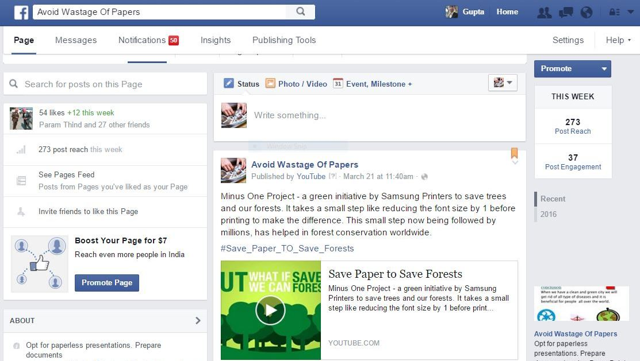

Slide 7
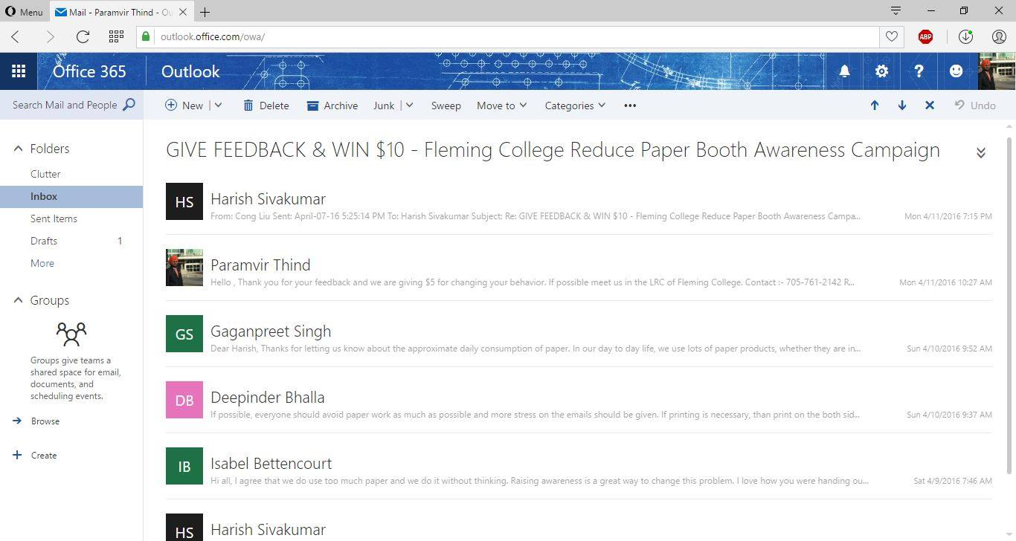
Feedback (Changing Behavior)

Slide 8
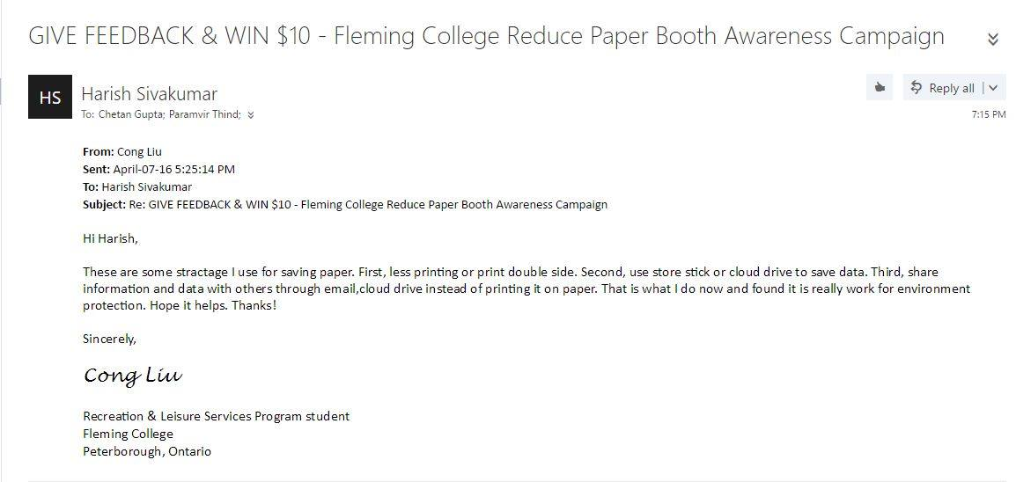
Feedback

Slide 9
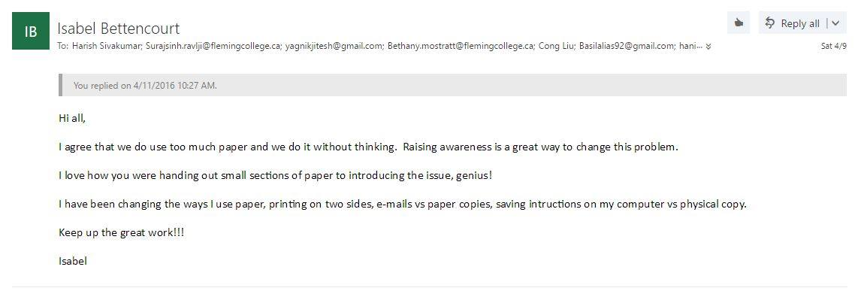
Feedback

Slide 10
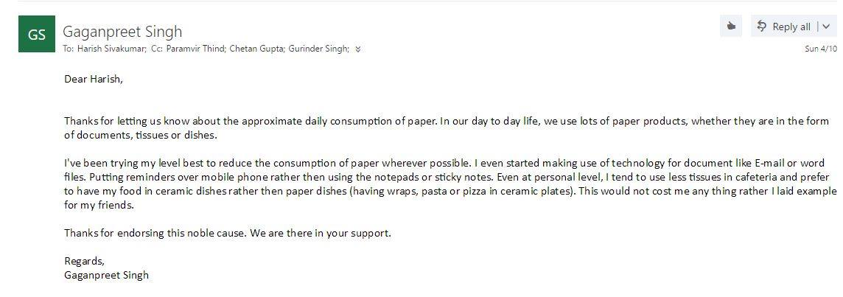
Feedback

Slide 11
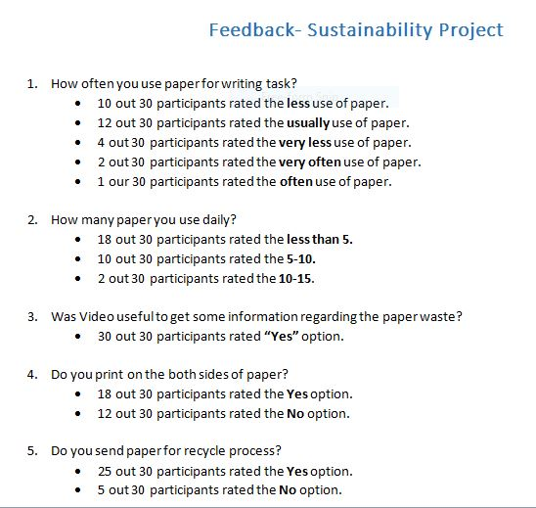

Slide 12
Tools and Techniques
Stall in the main foyer of Fleming college
Videos
Flyers
Feedback Form
Motivation
Gift card

Slide 13
Result
From the feedback, we got to know that they decreased the paper usage by
Using printing both sides
Reducing font size
Using emails rather than mails
Using cloth rather than paper towel
Spontaneous behavior changes
Recommendation from participants

Slide 14
Lesson Learned and Team work
Planning
Communication
Time Management
Team Management
Brain Storming
Effective team work
Helped to achieve success

Slide 15
recommendation
In each table keep the posters like
“Print both sides”
“Reduce font Size”
“Use electronic medium communication”
Use recycled paper
Separate disposal for paper waste

Slide 16
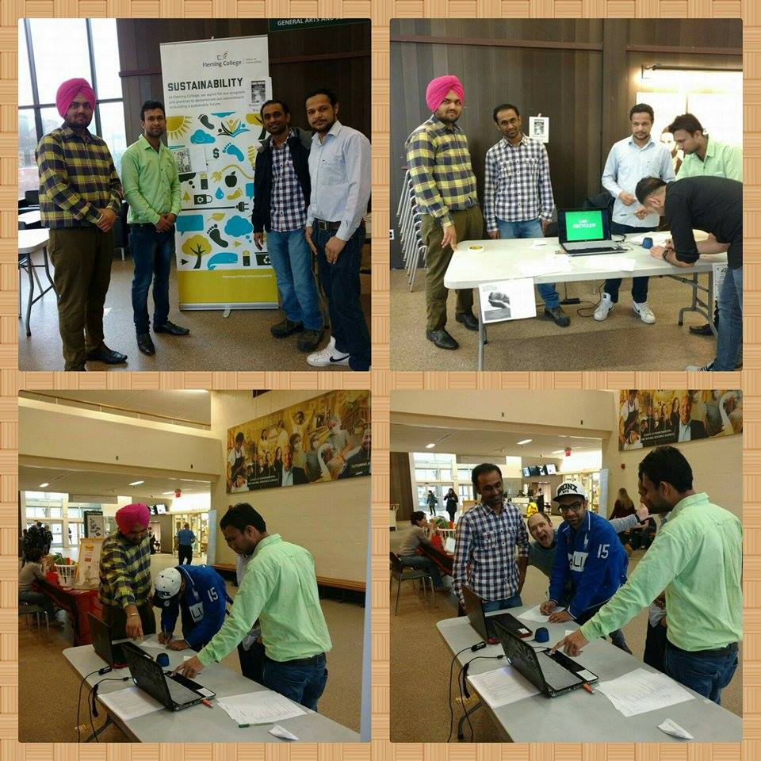

Slide 17
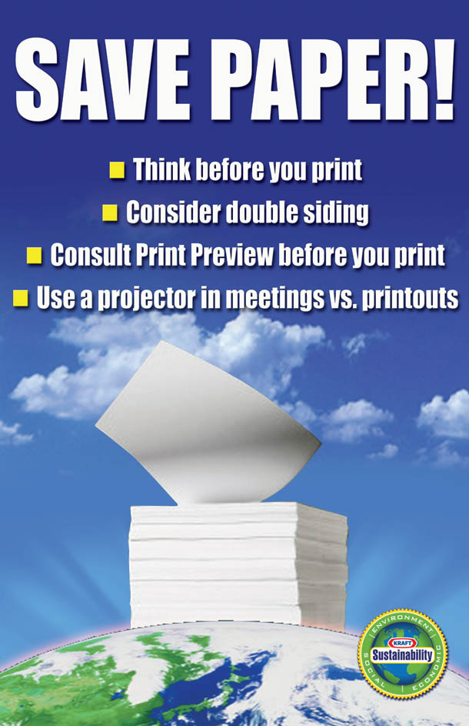
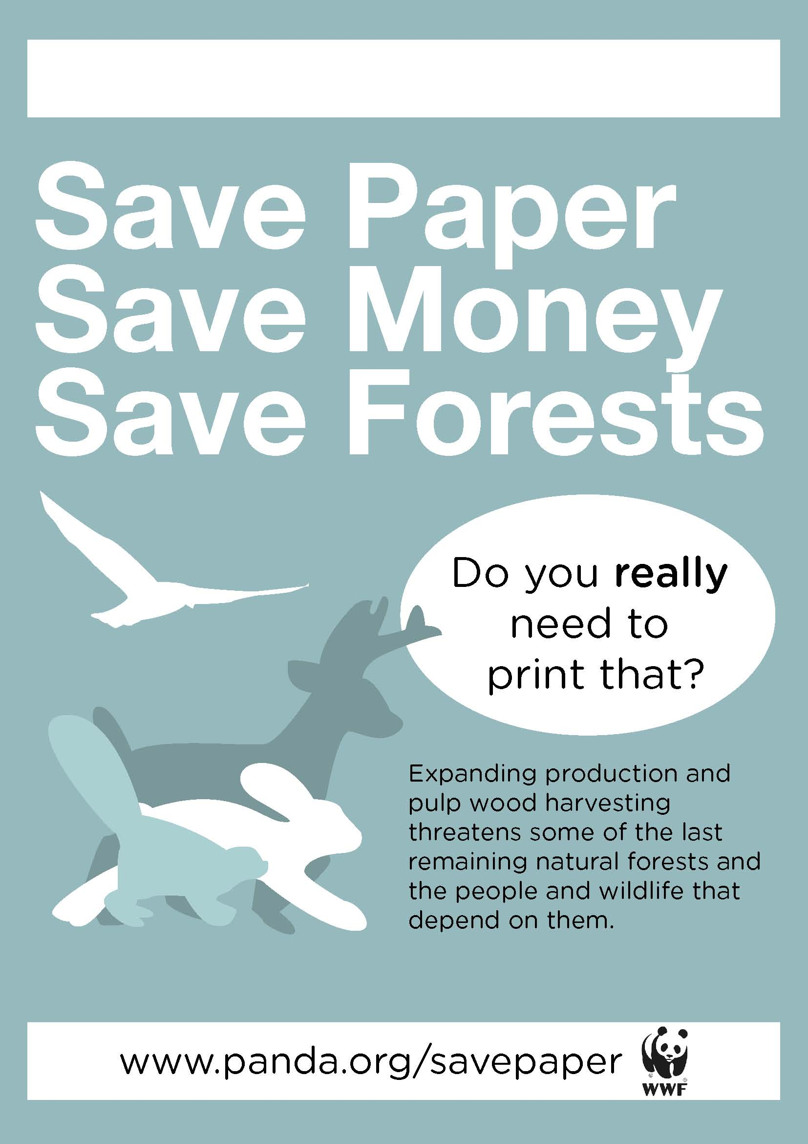
http://www.coroflot.com/sfostercom/posters
https://littlegreenmen101.wordpress.com/2011/10/18/why-save-paper/

