Slide 1
SUSTAINABILITY
BEST OUT OF WASTE
Presented to: Rogier ten Kate
Presented by: Kinjal Dutt
Mojisola Esan
Rakesh Parmar
Surajsinh Raulji
Jitesh Yagnik
Date: 14th April 2016
Source: Google image

Slide 2
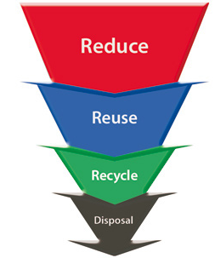
Source: Google image

Slide 3
FACTS AND FIGURES
Plastic bottle recycle ratio-1:5
Plastic decomposition time - 400 and 1,000 years
It requires 3 times the amount of water to produce a plastic bottle than it does to fill it

Slide 4
OBJECTIVES
Create awareness for waste reduction by creating items from waste.
Promote reuse of waste products like bottles, cans, paper etc.

Slide 5
EXECUTION
Approval from college
Made items out of waste
Display table at the main foyer showcasing items made out of waste
Involved students participation

Slide 6
EXECUTION

Slide 7
EXECUTION

Slide 8
CHALLENGES
Time conflicts among team members.
Students were too busy to participate.
Inability to involve faculty members.

Slide 9
OUTCOME
We created awareness regarding reuse of waste items.
Active participants gave suggestions like;
College should provide water bottles to every student
Students should make use of reusable bags instead of plastic bags.
Awareness should be made among students to bring their own coffee mugs.
Use steel cutleries at the cafeteria instead of plastic one.
Protect the environment through cultivation of plants around the college

Slide 10
RECOMMENDATION
College should display decorative items made from waste materials to encourage students to be more innovative.
Seminars should be held to demonstrate effective reuse of waste materials and encourage active participation by distributing gifts.
Competitions should be organized and be posted on the college social media/website.

Slide 11
Source: Google image

Slide 12
Hyperlink:
https://www.youtube.com/watch?v=edXimuzIVhk
https://www.banthebottle.net/articles/10-startling-facts-about-bottled-water/

